Slide 1
CSE 390 – Advanced Computer Networks
Lecture 10: DNS
(What’s in a Name?)
Based on Slides by D. Choffnes (NEU). Revised by P. Gill Fall 2014. Some content on DNS censorship from N. Weaver.

Slide 2
Administravia
Midterm: 1 week from today
Study guide posted on Piazza

Slide 3
Layer 8 (The Carbon-based nodes)
If you want to…
Call someone, you need to ask for their phone number
You can’t just dial “P R O F G I L L ”
Mail someone, you need to get their address first
What about the Internet?
If you need to reach Google, you need their IP
Does anyone know Google’s IP?
Problem:
People can’t remember IP addresses
Need human readable names that map to IPs

Slide 4
Internet Names and Addresses
Addresses, e.g. 129.10.117.100
Computer usable labels for machines
Conform to structure of the network
Names, e.g. www.northeastern.edu
Human usable labels for machines
Conform to organizational structure
How do you map from one to the other?
Domain Name System (DNS)

Slide 5
History
Before DNS, all mappings were in hosts.txt
/etc/hosts on Linux
C:\Windows\System32\drivers\etc\hosts on Windows
Centralized, manual system
Changes were submitted to SRI via email
Machines periodically FTP new copies of hosts.txt
Administrators could pick names at their discretion
Any name was allowed
alans_server_at_sbu_pwns_joo_lol_kthxbye

Slide 6
Towards DNS
Eventually, the hosts.txt system fell apart
Not scalable, SRI couldn’t handle the load
Hard to enforce uniqueness of names
e.g MIT
Massachusetts Institute of Technology?
Melbourne Institute of Technology?
Many machines had inaccurate copies of hosts.txt
Thus, DNS was born

Slide 7
Outline
DNS Basics
DNS Security
DNS and Censorship

Slide 8
DNS at a High-Level
Domain Name System
Distributed database
No centralization
Simple client/server architecture
UDP port 53, some implementations also use TCP
Why?
Hierarchical namespace
As opposed to original, flat namespace
e.g. .com → google.com → mail.google.com

Slide 9
Naming Hierarchy
Root
net
edu
com
gov
mil
org
uk
fr
etc.
Top Level Domains (TLDs) are at the top
Maximum tree depth: 128
Each Domain Name is a subtree
.edu → neu.edu → ccs.neu.edu → www.ccs.neu.edu
Name collisions are avoided
neu.com vs. neu.edu
neu
mit
ccs
ece
husky
www
login
mail

Slide 10
Hierarchical Administration
Verisign
Root
ICANN
net
edu
com
gov
mil
org
uk
fr
etc.
Tree is divided into zones
Each zone has an administrator
Responsible for the part of the hierarchy
Example:
CCIS controls *.ccs.neu.edu
NEU controls *.neu.edu
neu
mit
ccs
www
login
mail

Slide 11
Server Hierarchy
Functions of each DNS server:
Authority over a portion of the hierarchy
No need to store all DNS names
Store all the records for hosts/domains in its zone
May be replicated for robustness
Know the addresses of the root servers
Resolve queries for unknown names
Root servers know about all TLDs
The buck stops at the root servers

Slide 12
Root Name Servers
Responsible for the Root Zone File
Lists the TLDs and who controls them
~272KB in size
com. 172800 IN NS a.gtld-servers.net.
com. 172800 IN NS b.gtld-servers.net.
com. 172800 IN NS c.gtld-servers.net.
Administered by ICANN
13 root servers, labeled A→M
6 are anycasted, i.e. they are globally replicated
Contacted when names cannot be resolved
In practice, most systems cache this information

Slide 13
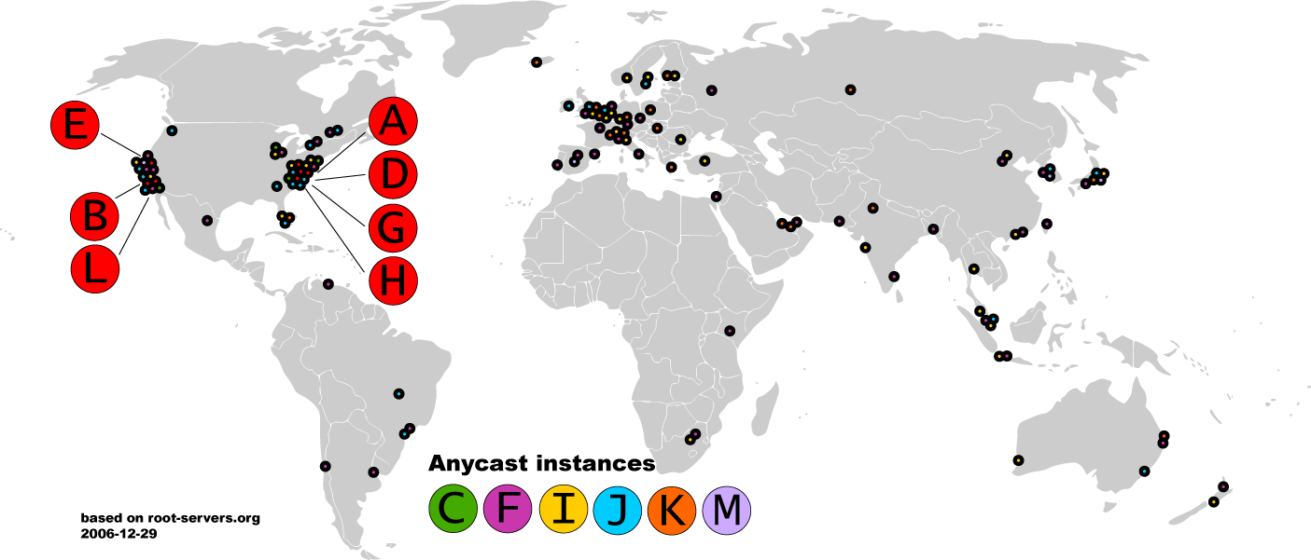
Map of the Roots

Slide 14


Local Name Servers
Where is google.com?
Northeastern
Each ISP/company has a local, default name server
Often configured via DHCP
Hosts begin DNS queries by contacting the local name server
Frequently cache query results

Slide 15
Authoritative Name Servers
www.neu.edu = 155.33.17.68
Where is www.neu.edu?
www.neu.edu
Northeastern
Root
edu
neu
Authority for ‘edu’
Authority for ‘neu.edu’
Stores the name→IP mapping for a given host

Slide 16
Basic Domain Name Resolution
Every host knows a local DNS server
Sends all queries to the local DNS server
If the local DNS can answer the query, then you’re done
Local server is also the authoritative server for that name
Local server has cached the record for that name
Otherwise, go down the hierarchy and search for the authoritative name server
Every local DNS server knows the root servers
Use cache to skip steps if possible
e.g. skip the root and go directly to .edu if the root file is cached

Slide 17
Recursive DNS Query
www.google.com
Where is www.google.com?
Puts the burden of resolution on the contacted name server
How does asgard know who to forward responses too?
Random IDs embedded in DNS queries
asgard.ccs.neu.edu
ns1.google.com
com
Root

Slide 18
Iterated DNS query
www.google.com
Where is www.google.com?
Contact server replies with the name of the next authority in the hierarchy
“I don’t know this name, but this other server might”
This is how DNS works today
asgard.ccs.neu.edu
ns1.google.com
com
Root

Slide 19
DNS Propagation
How many of you have purchased a domain name?
Did you notice that it took ~72 hours for your name to become accessible?
This delay is called DNS Propagation
www.my-new-site.com
Root
com
asgard.ccs.neu.edu
ns.godaddy.com
Why would this process fail for a new DNS name?

Slide 20
Caching vs. Freshness
DNS Propagation delay is caused by caching
Where is
www.my-new-site.com?
That name does not exist.
Cached Root Zone File
Cached .com Zone File
Cached .net Zone File
Etc.
asgard.ccs.neu.edu
Zone files may be cached for 1-72 hours
Root
com
www.my-new-site.com
ns.godaddy.com

Slide 21
DNS Resource Records
DNS queries have two fields: name and type
Resource record is the response to a query
Four fields: (name, value, type, TTL)
There may be multiple records returned for one query
What do the name and value mean?
Depends on the type of query and response

Slide 22
DNS Types
Type = A / AAAA
Name = domain name
Value = IP address
A is IPv4, AAAA is IPv6
Type = NS
Name = partial domain
Value = name of DNS server for this domain
“Go send your query to this other server”
Name: www.ccs.neu.edu
Type: A
Query
Name: www.ccs.neu.edu
Value: 129.10.116.81
Resp.
Name: ccs.neu.edu
Type: NS
Query
Name: ccs.neu.edu
Value: 129.10.116.51
Resp.

Slide 23
DNS Types, Continued
Type = CNAME
Name = hostname
Value = canonical hostname
Useful for aliasing
CDNs use this
Type = MX
Name = domain in email address
Value = canonical name of mail server
Name: foo.mysite.com
Type: CNAME
Query
Name: foo.mysite.com
Value: bar.mysite.com
Resp.
Name: ccs.neu.edu
Type: MX
Query
Name: ccs.neu.edu
Value: amber.ccs.neu.edu
Resp.

Slide 24
Reverse Lookups
What about the IP→name mapping?
Separate server hierarchy stores reverse mappings
Rooted at in-addr.arpa and ip6.arpa
Additional DNS record type: PTR
Name = IP address
Value = domain name
Not guaranteed to exist for all IPs
Name: 129.10.116.51 Type: PTR
Query
Name: 129.10.116.51 Value: ccs.neu.edu
Resp.

Slide 25
DNS as Indirection Service
DNS gives us very powerful capabilities
Not only easier for humans to reference machines!
Changing the IPs of machines becomes trivial
e.g. you want to move your web server to a new host
Just change the DNS record!

Slide 26
Aliasing and Load Balancing
One machine can have many aliases
www.reddit.com
david.choffnes.com
www.foursquare.com
alan.mislo.ve
www.huffingtonpost.com
*.blogspot.com
One domain can map to multiple machines
www.google.com

Slide 27
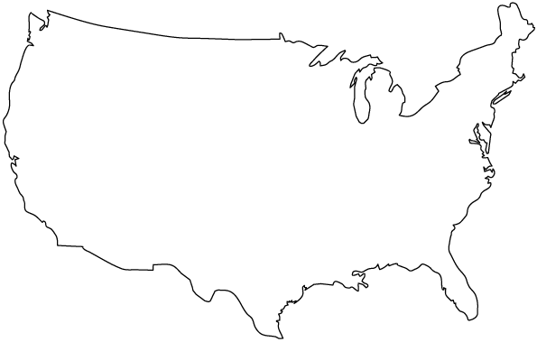


Content Delivery Networks
DNS responses may vary based on geography, ISP, etc

Slide 28
Outline
DNS Basics
DNS Security
DNS and Censorship

Slide 29
The Importance of DNS
Without DNS…
How could you get to any websites?
You are your mailserver
When you sign up for websites, you use your email address
What if someone hijacks the DNS for your mail server?
DNS is the root of trust for the web
When a user types www.bankofamerica.com, they expect to be taken to their bank’s website
What if the DNS record is compromised?

Slide 30
Denial Of Service
Flood DNS servers with requests until they fail
October 2002: massive DDoS against the root name servers
What was the effect?
… users didn’t even notice
Root zone file is cached almost everywhere
More targeted attacks can be effective
Local DNS server → cannot access DNS
Authoritative server → cannot access domain

Slide 31

DNS Hijacking
Infect their OS or browser with a virus/trojan
e.g. Many trojans change entries in /etc/hosts
*.bankofamerica.com → evilbank.com
Man-in-the-middle
Response Spoofing
Eavesdrop on requests
Race the servers response – Useful for censorship

Slide 32
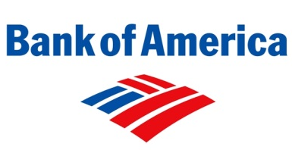


DNS Spoofing
Where is bankofamerica.com?
123.45.67.89
How do you know that a given name→IP mapping is correct?
Where is bankofamerica.com?
dns.bofa.com
66.66.66.93
123.45.67.89
dns.evil.com
66.66.66.93

Slide 33
DNS Cache Poisoning
Where is www.google.com?
Where is bankofamerica.com?
www.google.com = 74.125.131.26
dns.neu.edu
ns1.google.com
Until the TTL expires, all queries for BofA to dns.neu.edu will return poisoned result
Much worse than spoofing/man-in-the-middle
Whole ISPs can be impacted!
bankofamerica.com = 66.66.66.92

Slide 34
How will the attacker get his entry into the cache? 2 ways
1. Tell resolver that NS for victim is at adversary’s IP
Issue query: subdomain.attacker.example IN A
Attacker’s response:
Answer: (no response)
Authority Section: attacker.example. 3600 IN NS ns.target.example.
Additional Section: ns.target.example. IN A w.x.y.z
Adversary says “authoritative server for my domain is ns.target.example and oh by the way here is the IP for it (adversary’s IP)

Slide 35
How will the attacker get his entry into the cache? 2 ways
2. Redirect the NS record to the adversary’s domain
Issue query: subdomain.attacker.example IN A
Answer: (no response)
Authority section:
Target.example. 3600 IN NS ns.attacker.example.
Additional section:
Ns.attacker.example. IN A w.x.y.z
The attacker has inserted an unrelated piece of information that will be cached by the server
(that target.example.’s ADNS is ns.attacker.example.)

Slide 36
Solution: DNSSEC
Cryptographically sign critical resource records
Resolver can verify the cryptographic signature
Two new resource types
Type = DNSKEY
Name = Zone domain name
Value = Public key for the zone
Type = RRSIG
Name = (type, name) tuple, i.e. the query itself
Value = Cryptographic signature of the query results
Deployment
On the roots since July 2010
Verisign enabled it on .com and .net in January 2011
Comcast is the first major ISP to support it (January 2012)
Creates a hierarchy of trust within each zone
Prevents hijacking and spoofing

Slide 37

DNSSEC Hierarchy of Trust
Root Zone (ICANN)
.com (Verisign)
IP: 123.45.67.89
Key: < >
SIG: x9fnskflkalk
IP: 66.66.66.93
Key: < >
SIG: 9na8x7040a3
Where is bankofamerica.com?
dns.bofa.com
dns.evil.com

Slide 38
Does DNSSEC Solve all our problems?
No.
DNS still vulnerable to reflection attacks + injected responses

Slide 39
DNS Reflection
Very big incident in 2012
(http://blog.cloudflare.com/65gbps-ddos-no-problem/)
65 Gbps DDoS
Would need to compromise 65,000 machines each with 1 Mbps uplink
How was this attack possible?
Use DNS reflection to amplify a Botnet attack.
Key weak link: Open DNS resolvers will answer queries for anyone http://openresolverproject.org/

Slide 40
So how does this work?
Remember: DNS is UDP
No handshaking between endpoints
I can send a DNS query with a forged IP address and the response will go to that IP address
Secret sauce: a small request that can elicit a large response
E.g., query for zone files, or DNSSEC records (both large record types).
Botnet hosts spoof DNS queries with victim’s IP address as source
Resolver responds by sending massive volumes of data to the victim

Slide 41
DNS amplification illustrated
Src: Victim
Dst: Open Resolver
DNS …
Open Resolver
Victim
Sometimes the DNS resolver network thinks it is under attack by the victim!!
Src: Victim
Dst: Open Resolver
DNS …
Hosts infected by botnet

Slide 42
Amplification not unique to DNS
NTP is the latest protocol to be used in this way:
http://www.prolexic.com/news-events-pr-threat-advisory-ddos-ntp-amplification.html
(Exploiting NTP Monlist command which returns a list of 600 most recent hosts to connect to the NTP server)

Slide 43
Outline
DNS Basics
DNS Security
DNS and Censorship

Slide 44
DNS and Censorship
DNS is a popular protocol for targeting by Internet censors
A few things to keep in mind …
No cryptographic integrity of DNS messages
DNSSEC proposed but not widely implemented
Caching of replies means leakage of bad DNS data can persist

Slide 45
Blocking DNS Names

Slide 46
Blocking DNS Names
Can the censor pressure the ISPs?
Just force an entry in the recursive resolver to poison results for a given domain
Clients can trivially evade this using alternate DNS services
E.g., Google’s 8.8.8.8
…but this does require client changes
Also, ISPs must not block third party DNS queries for this to work
Initially used by ISPs in the UK to block the Pirate Bay

Slide 47

Types of false DNS responses
DNS RESPONSE A
192.168.5.2
DNS RESPONSE A
127.0.0.1
DNS RESPONSE A
159.106.121.75
NXDOMAIN
3rd Party DNS Server
(8.8.8.8)
DNS QTYPE A
www.censored.com
DNS Server
(2.1.2.3)
DNS RESPONSE A
1.2.3.5
(correct IP)
Block page server
(192.168.5.2)
Home connection
(2.1.2.4)
This diagram assumes ISP
DNS Server is complicit.

Slide 48
Blocking DNS names
Option A: get ISP resolver on board
(Previous slide)
Option B: On-path packet injection
Censor injects a DNS response that races the legitimate reply
Can be mostly countered with DNS-hold-open:
Don’t take the first answer but instead wait for up to a second
Generally reliable when using an out of country recursive resolve (e.g., 8.8.8.8, censor packet should win the race)
Can be completely countered by DNS-hold-open + DNSSEC
Accept the first DNS reply which validates

Slide 49
Reading from Web …
Hold-On: Protecting Against On-Path DNS Poisoning, H. Duan, N. Weaver, Z. Zhao, M. Hu, J. Liang, J. Jiang, K. Li, and V. Paxson.
Idea: Once you receive a DNS packet, wait for a predefined “hold-on” period before accepting the result.
DNSSEC is still vulnerable to these injected packets and does not make hold-on unneccessary
Censor can just inject a reply with an invalid signature: client will reject (denial of service)
Method: Use active measurements to determine the expected TTL and RTT to the server.

Slide 50
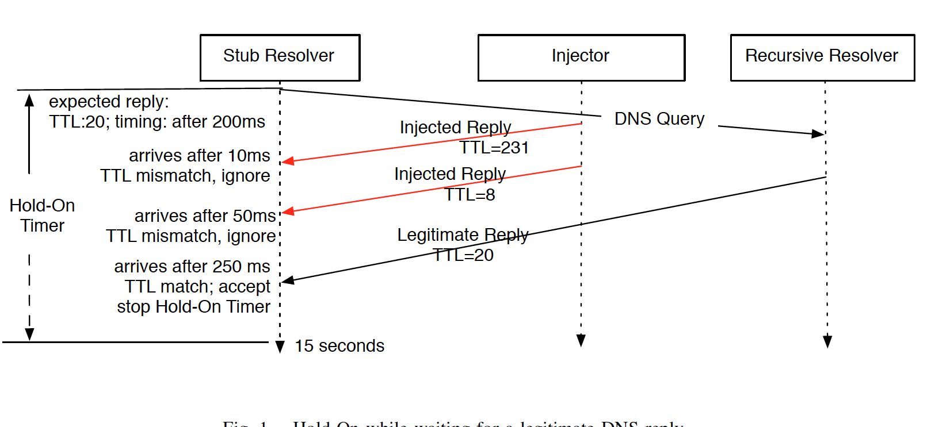
Hold-on in action

Slide 51
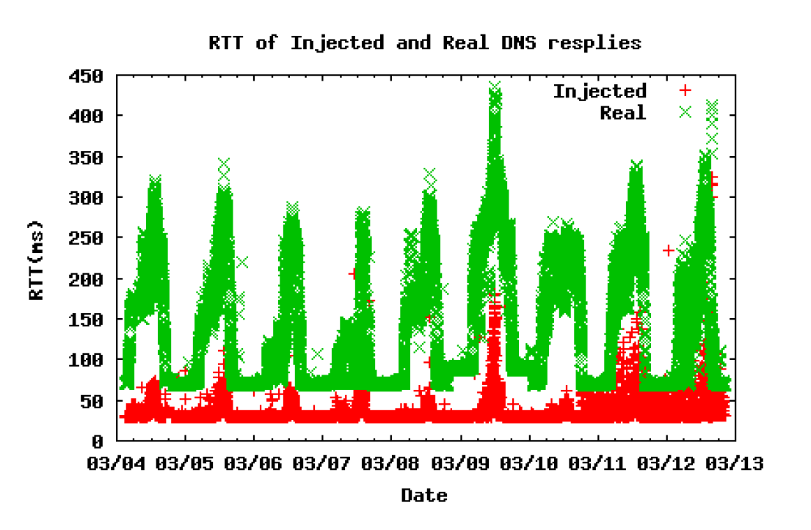
Checking feasibility: RTT

Slide 52
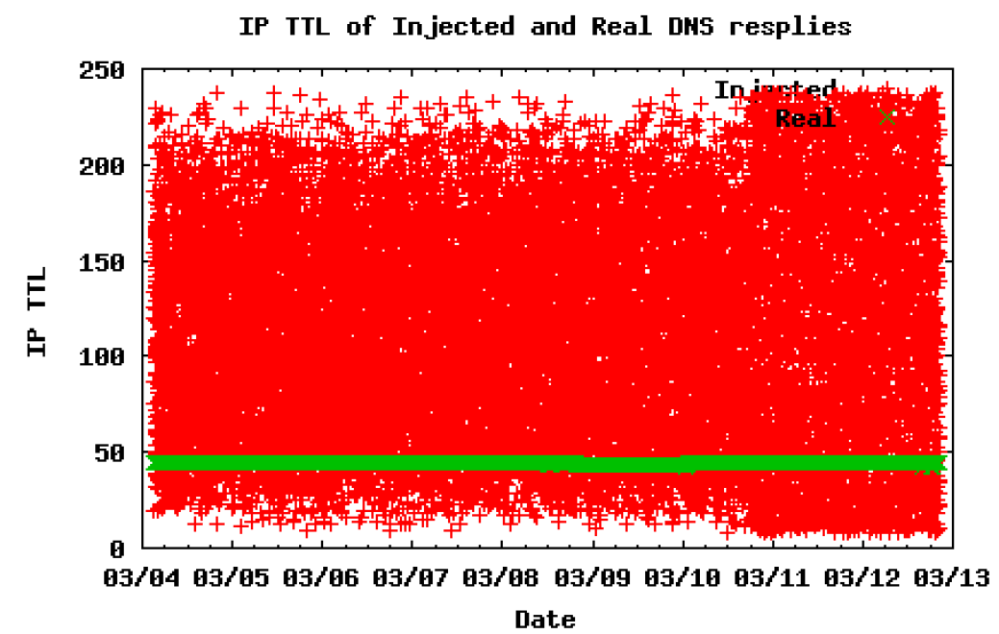
Checking feasibility: ttl

Slide 53
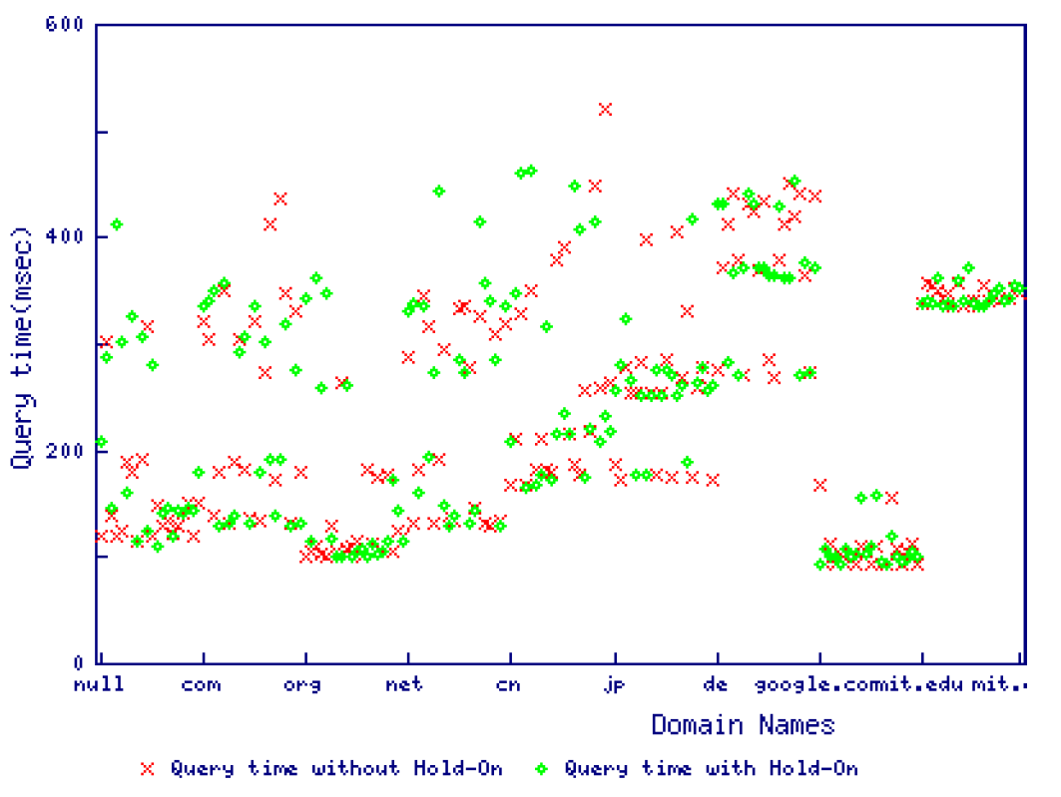
Performance of Hold-on
Lesson: You don’t have to wait that long to get the legitimate reply
Notes:
Potential project, create a browser plug in that implements hold-on.

Slide 54
Much More to DNS
Caching: when, where, how much, etc.
Other uses for DNS (i.e. DNS hacks)
Content Delivery Networks (CDNs)
Different types of DNS load balancing
Dynamic DNS (e.g. for mobile hosts)
DNS and botnets
Politics and growth of the DNS system
Governance
New TLDs (.xxx, .biz), eliminating TLDs altogether
Copyright, arbitration, squatting, typo-squatting

